Slide 1
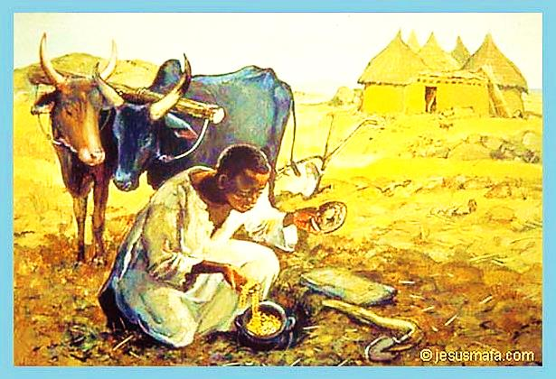
The Treasure in the Field

Slide 2
Note: Any videos in this presentation will only play online. After you download the slideshow, you will need to also download the videos from YouTube & add them back into your PowerPoint.
We present these messages at Bee Creek Park in College Station, TX. If you would like to watch the video of the service with this message, click here:
http://campaignkerusso.org/?p=10104
We would love to know more about the people who download our lessons & sermons. We invite you to email us & let us know where & how you use them.
info@ckbrazos.org

Slide 3
The kingdom of heaven is like treasure that was hidden in a field. When a man found it, he hid it again. He was very happy.

Slide 4
So he went and sold everything he had. And he bought that field. Matthew 13:44

Slide 5
A man finds a treasure hidden in a field:
He saw how valuable it was
He reburied it, to be saved for later
He bought the whole field just for that treasure
It cost him everything he had
He gladly gave up everything for his treasure

Slide 6
Christ was truly God. But he did not try to remain equal with God.
Instead he gave up everything and became a slave, when he became like one of us.
Christ was humble. He obeyed God and even died on a cross.
Then God gave Christ the highest place and honored his name above all others.
So at the name of Jesus everyone will bow down
Philippians 2:6-10

Slide 7
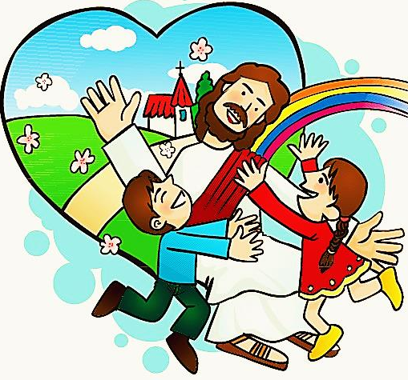
The man in the story is JESUS The field is the WORLD The treasure is HIS CHURCH
He paid with his life
He died for the whole field (the world)
Jesus thinks of us, as His treasure
We are hidden from the rest of the world
Jesus will “dig up” his treasure at the end of time

Slide 8
What is the Sinner‘s Prayer?
This is a prayer we can pray when we are ready to admit we are sinners and need Christ’s forgiveness.
It must be prayed with faith in our hearts and a readiness to have a life-changing encounter with Jesus Christ.

Slide 10
John Wesley’s Testimony
“…the preacher was describing the change which God works in the heart through faith in Christ and I felt my heart strangely warmed.”
Disciple’s Testimony
“They said to each other, ‘Did not our hearts burn within us while he talked to us on the road, while he opened to us the Scriptures?’”

Slide 11
A prayer of faith → Pray this prayer if :
If you never have before
You have in the past, but you think it would mean more today
You have been walking afar off and you want to come back
You want to set an example & show others how it is done
You just like to give your heart to Jesus again & again
Faith

Slide 12
We Declare Our Faith Publicly Because Jesus Declared His LOVE Publicly
“If you stand before others and are willing to say you believe in me, then I will tell my Father in heaven that you belong to me.” Mat 10:32

Slide 13
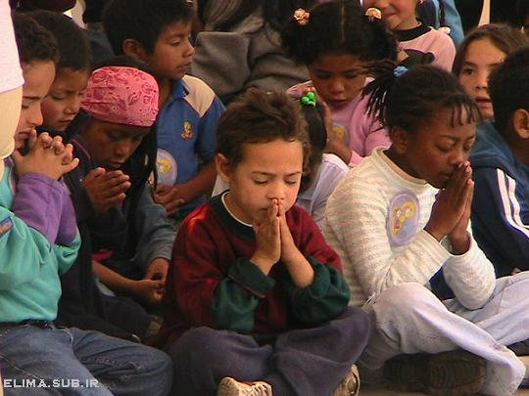
Dear Jesus,
I know I am a sinner & need your forgiveness.
I believe you died for my sins.
I now turn from sin.
Come into my heart I pray.
Do you want to meet Jesus as your savior right now?
Do you believe He died to save you from your sins & that He rose from the dead?
Do you believe that He is waiting to save you right now?

Slide 14
“But some people did accept him. They believed in him, and he gave them the right to become children of God.” John 1:12

Slide 16
“If you openly say, ‘Jesus is Lord’ and believe in your heart that God raised him from death, you will be saved.”
Rom. 10:9
What did you learn today?
What is the meaning of the name-tag?
What have you neen thinking about God lately?
What do you want to tell the world about Jesus?

Slide 17
“Draw near to God, and He will draw near to you…
…Cleanse your hands, you sinners, and make your hearts pure, you who are half-hearted towards God.” James 4:8 WNT

Slide 18
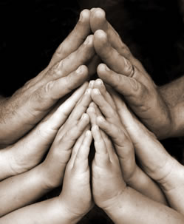
Close in Prayer

Slide 19
Note: Any videos in this presentation will only play online. After you download the slideshow, you will need to also download the videos from YouTube & add them back into your PowerPoint.
We present these messages at Bee Creek Park in College Station, TX. If you would like to watch the video of the service with this message, click here:
http://campaignkerusso.org/?p=10104
We would love to know more about the people who download our lessons & sermons. We invite you to email us & let us know where & how you use them.
info@ckbrazos.org

Slide 20
Welcome to Aggieland Faith Family Style Worship

Slide 21
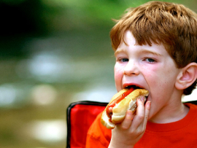
CURRENT SCHEDULE: See www.Aggielandfaith.org
SATURDAY —
At Bee Creek Park
2:00-4:00pm: Through the bible with felt-board stories – plus hot-dogs & drinks
SUNDAY —
At Bee Creek Park
2:00-4pm: Free snacks, drinks, kids crafts, prizes, singing & bible preaching

Slide 22
Would You Like Prayer or Bible Study at Your House?
Personal Prayer: We can come to your home & pray with you, or you can email us when you need prayer.
Home Bible Study: We will come to your home & hold a bible study for you & your friends.
Bible Party: We will hold a Kid’s Bible Party: You provide the food & kids - we will do the bible fun & stories.

Slide 23
Would You Like Visitation?
We will visit a friend, loved one in the hospital or in prison to pray for them & share Christ with them.
Contact: info@aggielandfaith.org

Slide 24
www.aggielandfaith.org
Go here to see pictures & videos
Go here to subscribe to e-mails about changes & cancellations

Slide 25
Note: Any videos in this presentation will only play online. After you download the slideshow, you will need to also download the videos from YouTube & add them back into your PowerPoint.
We present these messages at Bee Creek Park in College Station, TX. If you would like to watch the video of the service with this message, click here:
http://campaignkerusso.org/?p=10104
We would love to know more about the people who download our lessons & sermons. We invite you to email us & let us know where & how you use them.
info@ckbrazos.org

